Slide 1
Mining Causal Topics in Text Data: Iterative Topic Modeling with Time Series Feedback.
Reproducing Paper
Copyright is held by the owner/author(s). Publication rights licensed to ACM. ACM, New York, NY, USA, 885-890. DOI=10.1145/2505515.2505612
Using New York Times Data for U.S. Presidential Election Year 2000
&
Presidential Prediction Market Prices
Heta Desai (Team Leader) & Harpreet Siddhu
MCS in Data Science
CS 410: Text Information System
(Class of Falls 2020)

Slide 2
Scope:
The scope of this project is to reproduce the experimental results of an existing paper on Topic Mining with Time Series Feedback.
The original Paper was presented in 22nd ACM International conference on Information and Knowledge Management in October, 2013.
For More information, please check: https://dl.acm.org/doi/10.1145/2505515.2505612

Slide 3
Abstract
Many applications require analyzing textual topics in conjunction with external time series variables such as stock prices. This paper developed a novel general text mining framework to determine such casual topics from text data.
The framework can be used with any available probabilistic topic model (PLSA, LDA etc.) with time series casual analysis to discover topics which are both coherent semantically and correlated with the time series data.
The accuracy of the casual topics with time series depends on running the framework iteratively and providing feedback at each iteration by imposing prior distribution on parameters.

Slide 4
Important Terms
Casual Topic: A semantically coherent topic is “casual” if it has a strong association with non-textual time series variable.
Granger Test: It is a measure of causality, used to determine the statistical significance at different time lags. It is used to find the causality measure or significant measure.
We have used this for our implementation - grangercasualitytests)
Pearson correlations: Determines the relationship between two quantities. (“Stock price Vs. Word” in our case). The value of Pearson's Correlation Coefficient can be between -1 to +1. For example, 1 means that they are highly correlated (Positive impact) and 0 or less means no correlation (negative impact).

Slide 5
Important Terms Cont.
Average Causality Confidence: It is a quality measure for significance value (i.e. P-Value from the Granger Test) between the external time series and the text stream. The causality confidence increases with number of iterations because of prior information (Feedback mechanism).
Topic Purity: This is another quality measure to determine the impact orientation of significant words. Higher purity means a topic with same orientation words (positive impact only) and lower purity means mixed orientation words in a topic (positive and negative both).

Slide 6
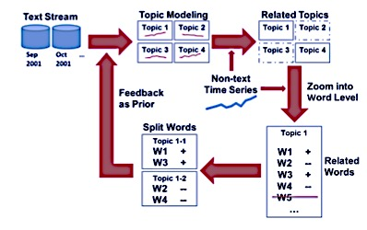
Overview - An Iterative Topic Modeling Framework with Time Series Feedback

Slide 7
Implementation Steps
Step 1: Text Dataset
Refine the NYT dataset for Presidential Election Blog Articles from 1st May 2000 to 30th October 2000 for keyword “Bush” & ”Gore”.
Step 2: Non Text Dataset (External Time Series Data)
Refine and create Presidential Prediction Market prices (from IOWA Electronic Market) dataset from 1st May 2000 to 30th October 2000 for democratic and republican candidate and determine normalized Probability.
Step 3: Topic Modeling (LDA) (GENSIM)
Run Latent Dirichlet Allocation algorithm on the dataset of Step 1 after preprocessing and creating a Gensim corpus.
Step 4: Topic Level Causality Analysis
Create a Topic Stream Time Series (aka TS) and run Granger Test to determine the causal topics with significant more than 95% for lag between 1 to 5.

Slide 8
Implementation Steps Cont.
Step 5: Word Level Causality Analysis
Similar to Step 4, create a word stream time series (aka WS).
Step 6: Calculate Prior, Average Causality Confidence & Average Purity of current Step
Use significant topic stream to determine the significant top words in the topic using Granger Causality test and then find out their impact using Pearson Correlation Coefficient. Based on impact analysis divide the topic into two i.e. Positive word and Negative word Topic.
Also calculate Average Causality confidence and Average Purity of that current iteration.
Step 7: Iterate Step 3 – 6 (Feedback)
Calculate prior in Step 6 and feed that again to STEP – 3 (LDA).
Step 8: Print and Plot Results
In the end (after 5th iteration), display the top words of most significant topic and plot average causality confidence and average purity line chart.

Slide 9
Project Repository
The implementation code, dataset and project documentations can be found here:
https://github.com/hetadesai26/CourseProject

Slide 10
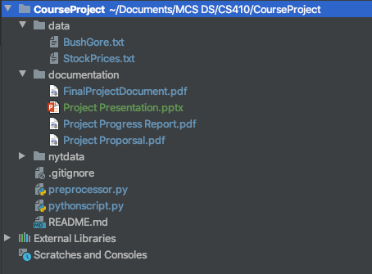
Project Directory Structure

Slide 11
Next few Slides Will Cover:
Instructions on how to install the dependencies.
Instructions on how to setup local environment to run the software.
Examples of use case/testing result to show how our implementation is working and matching with the framework presented in the paper.

Slide 12
What’s Required To Run Project In Local?
How to install dependencies:
Gensim: https://radimrehurek.com/gensim/models/ldamodel.html
Run “pip install gensim” on the command line to install.
Nltk: https://www.nltk.org/_modules/nltk/tokenize/regexp.html
Run “pip install nltk” on the command line to install.
Numpy: https://numpy.org/
Run “pip install numpy” on the command line to install.
Matplotlib: https://matplotlib.org/
Run “pip install matplotlib” on the command line to install.

Slide 13
What’s Required To Run Project In Local?
How to install dependencies Cont.
Statsmodels: “pip install statsmodels” https://www.statsmodels.org/stable/generated/statsmodels.tsa.stattools.grangercausalitytests.html
xml.etree.ElementTree: “pip install pycopy-xml.etree.ElementTree” https://docs.python.org/3/library/xml.etree.elementtree.html
Same way you can install other dependencies as well. fnmatch, re and os
Itertools: https://docs.python.org/3/library/itertools.html
Scipy: https://www.scipy.org/
NOTE: If you are using an editor like PyCharm then it will automatically notify you to import these packages and will install for you in background.

Slide 14
Instructions on how to setup local environment to run the software.
Clone the repository on your local system by running following command on the terminal –
“git clone https://github.com/hetadesai26/CourseProject.git”
The folder structure will look like this:
Where,
NYTData is the New York Times blog articles directory for year 2000 from May to October 2000.
Data directory consist of two datasets – BushGore.txt and StockPrices.txt
Documentation directory contains project proposal, project progress report, project documentation and presentation.
preprocessor.py is the program used to create BushGore.txt dataset.
pythonscript.py is the actual implementation of paper.

Slide 15
Instructions on How To Use/Run in Local- Cont.
Once repository is cloned to local machine and all python modules are installed, Run following command: (make sure you in CourseProject repository before running the command)
python3 -W ignore PythonScript.py

Slide 16
Test Results showing Top significant words Related To 2000 Presidential Election
0. million campaign republicans democrats gun control national
1. george gov vice presidential al president texas campaign
2. health plan care drug medicare government education children
3. nader party ralph green george chance candidate
4. new teachers scores report hollywood period worth
5. budget spending billion said surplus trillion years
6. abortion rights platform said dr hand life
7. said hispanic people school going sure schools
8. won governor gasoline ll wrong republicans come
Top Four Significant Words From The Experiment Results Of Actual Paper
tax cut, oil energy, abortion, gun control

Slide 17
Test Results showing Top significant words Related To 2000 Presidential Election
0. oil said big prices commission price campaign
1. said clinton new received tour national campaign
2. social plan security said tax drug medicare
3. abortion said rights platform lazio june woman
4. money spending budget tax surplus federal campaign
5. health care tax education million children federal insurance
Top Four Significant Words From The Experiment Results Of Actual Paper
tax cut, oil energy, abortion, gun control

Slide 18
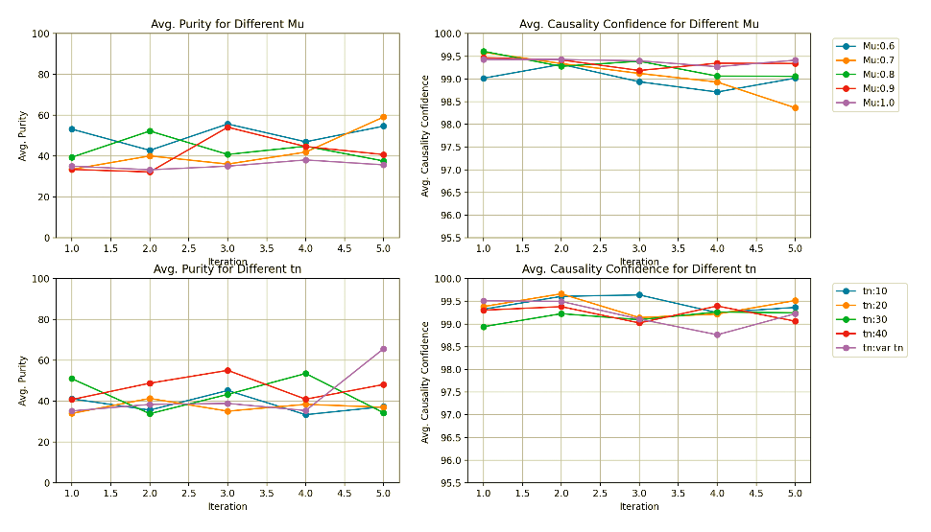
Causality confidence and purity (right) with different parameter settings over iteration (Presidential election data, Granger tests)

Slide 19
Deviation From Paper
Probabilistic Topic Modeling
In the paper the authors have used the Lemur PLSA but in our implementation we have used Gensim LDA.
Mu (Prior Strength)
In paper Mu is the value that controls the weightage of the prior. Instead of using the mu values provided in the paper we considered decay as the Mu parameter. Decay in the LDA model works similar to mu and is used to control the rate of forgetting the previous values.
Lag
We tried 2 approaches for selecting the best lag for words. One was to use the same lag as the topic and the other was to take the best lag for word independent from that of the topic. When comparing the both we found that the second approach gave better results.

Slide 20
Our Results Vs. Results From Paper
Completed the entire implementation of the paper and our results were similar to that showed in the paper.
There are words that were found in the implementation which are not seen in paper but are some important 2000 presidential election related words.
The difference in the plots and the output words between the implementation and the paper are because of the above deviations mentioned.

Slide 21
Video Tutorial: Execution of Implemented In Local Environment
https://www.youtube.com/watch?v=7eKNR8kWMwM

